Slide 1


WCF
4NET
SUPINFO Official Document
Notes:
© SUPINFO International University - http://www.supinfo.com
SUPINFO vous permet de partager ce document
Vous êtes libre de :
Partager — reproduire, distribuer et communiquer ce document Remixer — modifier ce document
A condition de respecter les règles suivantes :
Indication obligatoire de la paternité — Vous devez obligatoirement préciser l’origine « SUPINFO » du document au début de celui-ci de la même manière qu’indiqué par SUPINFO International University – Notamment en laissant obligatoirement la première et la dernière page du document, mais pas d'une manière qui suggérerait que SUPINFO International University vous soutiennent ou approuvent votre utilisation du document, surtout si vous le modifiez. Dans ce dernier cas, il vous faudra obligatoirement supprimer le texte « SUPINFO Official Document » en tête de page et préciser notamment la page indiquant votre identité et les modifications principales apportées.
En dehors de ces dispositions, aucune autre modification de la première et de la dernière page du document n’est autorisée.
NOTE IMPORTANTE : Ce document est mis à disposition selon le contrat CC-BY-NC-SA Creative Commons disponible en ligne http://creativecommons.org/licenses ou par courrier postal à Creative Commons, 171 Second Street, Suite 300, San Francisco, California 94105, USA modifié en ce sens que la première et la dernière page du document ne peuvent être supprimées en cas de reproduction, distribution, communication ou modification. Vous pouvez donc reproduire, remixer, arranger et adapter ce document à des fins non commerciales tant que vous respectez les règles de paternité et que les nouveaux documents sont protégés selon des termes identiques. Les autorisations au-delà du champ de cette licence peuvent être obtenues à support@supinfo.com.
© SUPINFO International University – EDUCINVEST - Rue Ducale, 29 - 1000 Brussels Belgium . www.supinfo.com

Slide 2

Objectives
WCF and Web Services
By completing this course, you’ll be able to:
Explore SOA concept
Discover and use SOAP
Create a simple WCF Service
Host & Consume WCF Services

Slide 3


Course plan
WCF and Web Services
Service Oriented Architecture
Services in .NET
WCF Services
Host & Consume

Slide 4
Service oriented architecture
WCF - Introduction

Slide 5

Introduction to Services
Service Oriented Architecture
SOA is a loosely-coupled architecture designed to meet the business needs of the organization.
– Microsoft
SOA is a set of components which can be invoked, and whose interface descriptions can be published and discovered
– W3C
Notes:
https://msdn.microsoft.com/en-us/library/bb833022.aspx

Slide 6
Introduction to Services
Service Oriented Architecture
SOA : Services Oriented Architecture
OOP complement
Used in processing and communicating with Services
SOA objectives
Productive
Reactive
Capable of managing responsibility
Notes:
On peut citer la SNCF, qui a mis en place une architecture de type SOA pour son système de réservation (recherche d'horaire, demande de tarif, réservation...) qui prend en charge à la fois les terminaux des guichets des agences et gares, et les sollicitations de son site web de commande en ligne
Les architectures SOA reposent principalement sur l’utilisation d’interface d’invocation (SOAP) et de vocabulaire de description de données (WSDL et XML) qui doivent être communs à l’ensemble des agents (fournisseurs de services et utilisateurs de services).
la notion de SOA (pour architecture orientée services) définie un modèle d'interaction applicative mettant en oeuvre des connexions en couplage lâche entre divers composants logiciels (ou agents). Ici, on entend par "service" une action exécutée par un composant "fournisseur" à l'attention d'un composant "consommateur", basé éventuellement sur un autre système.

Slide 7
Introduction to Services
Service Oriented Architecture
Service are based on 4 principles:
The borders are explicit
The services are independent of one another
Contracts are shared, but not objects
Semantics are dictated by rules
Notes:
Les frontières d’un service sont explicites : Le client et le développeur sont conscients que l’appel aux méthodes distantes se fait à travers des messages et passent par le réseau. Cela permet par exemple d’utiliser d’autres méthodes que la classique demande/réponse synchrone qui est utilisée pour simuler l’appel à une méthode locale.
Les services sont indépendants : Un service est autonome, et donc ce sont les clients qui doivent s’adapter lors de l’évolution d’un service à une nouvelle version. L’avantage est qu’ainsi l’interaction entre plusieurs services se fait naturellement et les services s’adaptent entre eux aux nouvelles contraintes. Il est donc important pour le service de gérer les erreurs, surtout pour les clients qui ne seraient pas à jour.
L’utilisation d’un service est décrite à l’aide d’un contrat : Le contrat est un représenté par un fichier XML. Il contient entre autres la structure des informations contenues dans les messages entrant et sortant. Ce contrat peut contenir de commentaires. Le contrat est souvent utilisé pour définir la construction des classes du client.
La sémantique est dictée par des règles : La sémantique, le format des messages et la stratégie d’accès au service peuvent être spécifiés (si nécessaire) dans le contrat par des règles. Ainsi, un service peut définir qu’il n’accepte que les messages entrants encryptés d’une certaine façon, ou encore qu’il n’est accessible que dans une tranche horaire définie, etc. La définition de cette sémantique peut être consommée par un framework, pour que l’encryptage des données se fasse automatiquement sans intervention du développeur du client, par exemple.

Slide 8
Introduction to Services
Service Oriented Architecture
Services are…
Self contained business functions
Functionnality exposed via a structured messaging scheme
Not just XML, not just HTTP
XML, SOAP, JSON, Images…
HTTP, TCP, Message Queues, …
Notes:
http://blogs.msdn.com/b/bashmohandes/archive/2007/08/11/soa-via-wcf-part-1.aspx

Slide 9
Introduction to Services
Service Oriented Architecture
A service and clients communicates by messages.
A client sends a request, the server sends back a response.

Slide 10
Advantages and Disadvantages
Service Oriented Architecture
Advantages:
Interoperability
Simplified access
Accessible data exchange format
Centralized arrangement
Disadvantages:
Poor performance
Ever-changing standards
Notes:
Avantages :
Interopérabilité : Un service web développé en .Net pourra être consommé en Perl, en Java, en PHP…
Accès simplifié : L’utilisation d’HTTP comme protocole d’accès aux services web évite les problèmes liés à l’utilisation de firewalls
Format d’échange accessible : Les échanges entre le client et le service web est au format texte, ce qui facilite la compréhension et l’exploitation
Mise à disposition centralisée : Services permettent de mettre à disposition à un seul endroit un composant utilisé en interne ou de le fournir à des prestataires ou des clients
Inconvénients :
Services ne sont pas performants : L’utilisation de format texte, des standards du web et la compatibilité entre plate formes sont à ce prix
Une technologie en perpétuelle évolution : Les normes et les fonctionnalités ne cessent d’évoluer

Slide 11
SOA Data Exchange
Service Oriented Architecture
SOA is just a way to organize, not the actual data transmission
Data exchange done in many ways
JSON
XML
…
Let’s see SOAP, a robust XML data exchange protocol

Slide 12

SOAProtocol
Service Oriented Architecture
Allows the transmission of structured and formatted data in messages between 2 distant objects.
Standard defined by W3C
Based on XML
Current version: 1.2

Slide 13
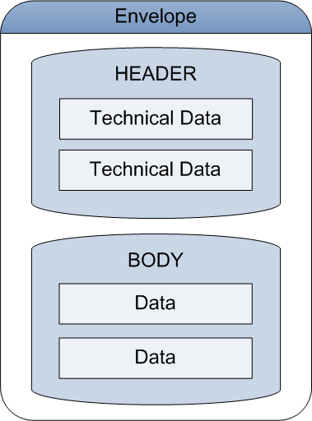
Composition of a Message
Service Oriented Architecture
Envelope:
Root element of SOAP message
Contains no or several attributes
Contains
Header (optional)
Body (mandatory)

Slide 14
Composition of a Message
Service Oriented Architecture
Header :
Used for adding complementary information to the message
Contains arguments: actor, mustUnderstand…
Body :
Contains data of the message
Corresponds to the XML Schemas specified in the service contract.

Slide 15
SOAP Protocol example
Service Oriented Architecture
<soap:Envelope xmlns:"http://schemas.xmlsoap.org/soap/envelope"/>
<soap:Header>
</soap:Header>
<soap:Body>
</soap:Body>
</soap:Envelope>

Slide 16
SOA Call Definition Exchange
Service Oriented Architecture
We saw SOA structure and data structure example
We need to know how to call the services
Methods
Properties
Return types
This is usually done by a WSDL file

Slide 17
WSDL Format
Service Oriented Architecture
WSDL defines, in an abstract and independent way, a group of operations and messages which can be transmitted to and from a given Service.
– JDNET Developers

Slide 18
WSDL Format
Service Oriented Architecture
Description language of Services in XML format
Used to draft a Service: describing functionalities
“how”
“where”
Current version: 2.0

Slide 19
WSDL Format
Service Oriented Architecture
WSDL is a Contract
Location
Operations Description
Type Description
Notes:
Le format wsdl sert a décrire un Service :
Comment on communique avec ?
Ou il se trouve ?
Quelles opérations on peut faire avec ?
Avec quelles données ?

Slide 20
<definition>
<type />
<message/>
<operation>
<message />
</operation>
<portType>
<operation/>
</portType>
<binding>
<operation/>
</binding>
<service>
<port>
<binding/>
</port>
</service>
</definition>
WSDL Example Skeleton

Slide 21

UDDI Directory
Service Oriented Architecture
Universal Description, Discovery and Integration
It is a directory of Services
which is a Service itself
It contains:
information on service providers (contracts, activities…)
description on services (as part of the WSDL contract)

Slide 22



UDDI Directory
Service Oriented Architecture
1. I am looking for a Service…
UDDI
2. Tell you how to connect to it.
3. What is the format for messages?
5. I send my SOAP requests.
Server
4. Here is my WSDL contract.
6. Result for the SOAP request.

Slide 23
SOA Facts
Service Oriented Architecture
SOA…
Is a technology
No, it’s a design philosophy independent of any vendor, product, technology or industry trend.
Require Web Services
No, SOAs may be realized via Web services but Web services are not necessarily required to implement SOA
Notes:
Derived from https://msdn.microsoft.com/en-us/library/bb833022.aspx

Slide 24
SOA Facts
Service Oriented Architecture
SOA…
Reference Architecture reduces implementation risk
“SOAs are like snowflakes – no two are the same” – David Linthicum
May not necessarily provide the best solution for an organization
Requires a complete technology
No, SOA should be incremental and may be done with several tools
We need to build a SOA
SOA is a means, not an end
Notes:
Derived from https://msdn.microsoft.com/en-us/library/bb833022.aspx

Slide 25


Questions?

Slide 26
Services in .NET
WCF - Introduction

Slide 27
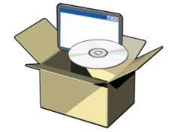

A Unified Programming Model
Services in .NET
Many confusing and complicated options
Remoting
COM
DCOM
WSE
BEFORE
MSMQ
ASMX
COM+
Windows Communication Foundation
AFTER
A unified development model
Notes:
**

Slide 28
Windows Communication Foundation
Services in .NET
Framework for Service-Oriented Architectures (SOAs)
Send data from one service endpoint to another
Service can be hosted in web server (IIS) or not
Client can be any type of application
Message can be any type the parties agree on, text (XML) or binary
Notes:
IIS = Internet Information Services TCP = Transmission Control Protocol

Slide 29
Windows Communication Foundation
Services in .NET
Request: REST…
Protocol: HTTP, TCP…
Client
endpoint
Server
endpoint
Response: XML, Atom, JSON, binary…

Slide 30
3 Options
Services in .NET
WCF
WCF Data Services
WCF RIA Services
RIA : Rich Internet Application
RCA : Rich Client Application

Slide 31
WCF Service Frameworks
Services in .NET
Service-oriented
Client calls a service on the server
Server executes the required service & returns the result
Extra layer of abstraction
Unified and Simplified Web Services

Slide 32
WCF
Services in .NET
Layer lets role redistribution
Developer: Creates his service without having to take into account the target implementation
Integrater: Determines protocol and security

Slide 33
WCF
Services in .NET
Uses SOAP between processes
Composed of:
Service Class
Host Environnement
Endpoints (see more later)

Slide 34
WCF Web HTTP Services
Services in .NET
WCF Web Services often based on SOAP protocol
HTTP protocol plus XML data format
Compatible with Web Services on other platforms
WCF Web HTTP Services sometimes don’t use SOAP
Requested service & parameters are defined through a URI
Response can be XML, JSON, binary, …
Notes:
JSON = JavaScript Object Notation SOAP = Simple Object Access Protocol
URI = uniform resource identifier

Slide 35
WCF Web HTTP Services
Services in .NET
Lightweight WCF
No configuration on the client
No data contract
Can be consumed by any type of application
JSON format is more concise than XML
Notes:
JSON = JavaScript Object Notation SOAP = Simple Object Access Protocol
URI = uniform resource identifier

Slide 36
JSON
Services in .NET
JSON is an alternative to XML to represent data
More concise
Often used for web applications
Notes:
JSON = JavaScript Object Notation SOAP = Simple Object Access Protocol
URI = uniform resource identifier

Slide 37
<Students>
<Student>
<IDStudent>d161ee53-b3fe-4376-a5e1-2c616637d70d</IDStudent>
<Name>David</Name>
<Email>David@2620Course.com</Email>
<IDTeacher>aa7195cb-f6fc-4390-b7d1-c598ddaacbe9</IDTeacher>
<Street>111 Vine St.</Street>
<City>Mercer Island</City>
<State>WA</State>
<Zip>99999</Zip>
</Student>
</Students>
XML

Slide 38
[{
idstudent:'d161ee53-b3fe-4376-a5e1-2c616637d70d',
name:'David',
email:'David@2620Course.com',
idteacher:'aa7195cb-f6fc-4390-b7d1-c598ddaacbe9',
street:'111 Vine St.',
city:'Mercer Island',
state:'WA',
zip:99999
}]
JSON
{ } defines an object
[ ] defines a collection

Slide 39
WCF Service Frameworks
Services in .NET
WCF Data Services is data-oriented
Framework built on top of WCF and the Entity Framework
Brings the Entity Framework entities to the client
Allows clients to request data with REST syntax
WCF Data Services are said to be RESTful
Data can be returned in AtomPub or JSON formats
Notes:
API = application programming interface
AtomPub = Atom Publishing Protocol
RIA = rich Internet application

Slide 40
WCF Data Services
Services in .NET
Previously called ADO.NET Data Services
Create services that use the ODATAProtocol using RESTful semantic.
Server and Client libraries

Slide 41
WCF RIA Services
Services in .NET
Server-side technology that automatically generates client-side objects
Deal with the server for you
Provides client-side validation
Can be used for Silverlight or ASP.NET MVC clients

Slide 42
WCF and SOA
Services in .NET
WCF supports SOA:
Most developers do not have to learn WSDL
Lots of functionalities are handled by the runtime
Tools to enable easy creation and consumption of services
However:
Just because you exposed an interface over a Web service does not mean that you have created part of an SOA
WCF is a distribution mechanism, SOA is just a concept

Slide 43
Questions?

Slide 44
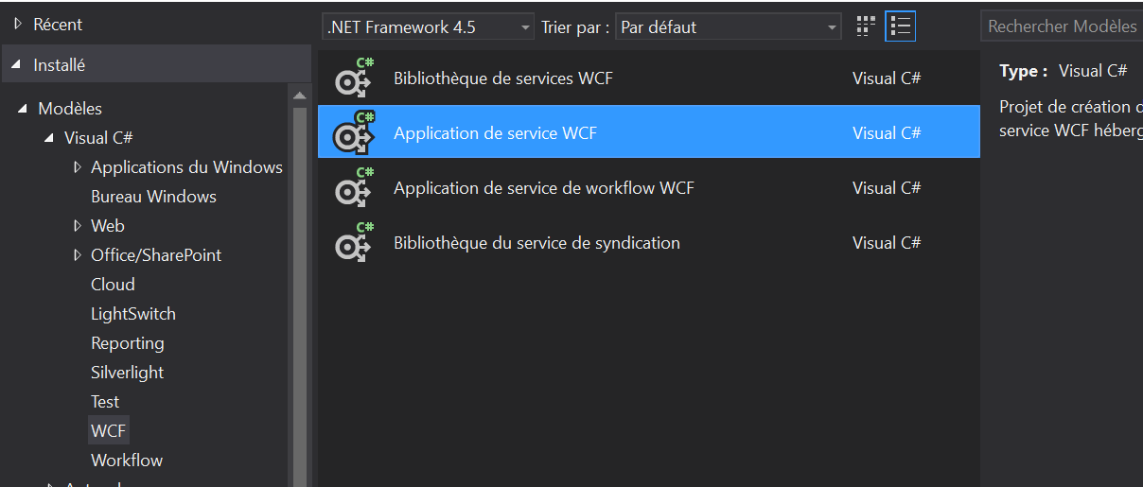
Exercise (1/6)
Service Oriented Architecture
Create a new WCF Application Service

Slide 45
Exercise (2/6)
Service Oriented Architecture
Your service will have three functions:
List<Person> GetPersons()
void CreatePerson()
Person GetPerson(int idBooster)
Write in IYourService.cs the method signatures

Slide 46
Exercise (3/6)
Service Oriented Architecture
Create a class Person with these properties:
A string FirstName
A string LastName
An int Age
An int IdBooster
Get inspiration from CompositeType in IYourService.cs
Create in YourService.svc a static List<Person>
We’ll use it to save our Person objects

Slide 47
Exercise (4/6)
Service Oriented Architecture
Remove from YourService.svc :
GetData()
GetDataUsingDataContract()
Remove from IYourService.cs :
GetData() signature
GetDataUsingDataContract() signature
CompositeType definition

Slide 48
Exercise (5/6)
Service Oriented Architecture
Launch your project and send some values
Use the WCF Test Client to do that!
To launch WCF Test Client:
Click on YourService.svc
Hit F5 key

Slide 49
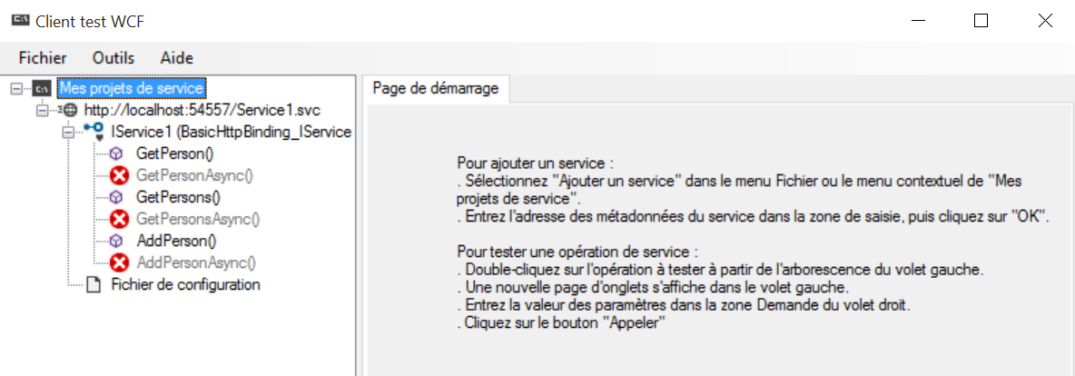
Exercise (6/6)
Service Oriented Architecture
Verify that your service works:
Notes:
C:\Program Files (x86)\Microsoft Visual Studio 12.0\Common7\IDE\WcfTestClient.exe

Slide 50
WCF Services
WCF and Web Services

Slide 51
Service Definition
WCF Services
Add the WebGet attribute on published methods
Clients will call with the GET HTTP verb
UriTemplate: method name in URI used by the client
ResponseFormat indicates the format : XML or JSON
[WebGet(UriTemplate = "Teachers", ResponseFormat = WebMessageFormat.Json)]
List<Teacher> TeacherList();

Slide 52
Service Definition
WCF Services
WebInvoke attribute used for HTTP verbs like POST
Parameters can be defined
[WebInvoke(UriTemplate = "TestPost", Method = "POST", ResponseFormat = WebMessageFormat.Json, RequestFormat = WebMessageFormat.Json)]
int Test(string value);
[WebGet(UriTemplate = "Teacher?init={Initial}")]
Teacher GetTeacher(string Initial);

Slide 53
Example of a Simple Contract
WCF Services
using System;
using System.ServiceModel;
namespace ServiceContracts
{
[ServiceContract(Namespace="http://myuri.org/Hello")]
public interface IService
{
[OperationContract]
HelloMessage GetHelloMessage(string name);
}
}
Principal namespace for WCF
Attributes control exposure of types and methods

Slide 54
The ServiceContract Attribute
WCF Services
Can be used on interfaces or classes
Identified by tools & environments understanding WCF
Service Contracts :
Support services
Analogous to interfaces on a polymorphic object – caller may not know or care about other contracts
Only visible to clients if exported on an endpoint
Contains one or more operations

Slide 55

The ServiceContract Attribute
WCF Services
Namespace serves to disambiguate types and operations in service metadata
Defaults to http://tempuri.org
Not to be confused with language-level namespace

Slide 56
The OperationContract Attribute
WCF Services
Used on methods
Not other class elements (i.e. properties or indexers)
Identified by tools & environments understanding WCF
Methods are only visible in service contract if marked with OperationContract

Slide 57
Data and messages
WCF Services
Parameters and return marshaled between client and server
CLR types are mapped to XML Infoset by serialization
WCF enables you to define custom serialization

Slide 58
Data and messages
WCF Services
Serialized data is packed into the message
Contents and structure of message must be understood by client or service at the other end
Data and message contracts provide control over these areas

Slide 59
Defining a data contract
WCF Services
using System;
using System.Runtime.Serialization;
namespace DataContracts {
[DataContract]
public class HelloMessage
{
private string _content;
[DataMember]
public string Content
{
get { return _content; }
set { this._content = value;}
}
} }

Slide 60
Implementing a service contract
WCF Services
Define a class implementing the service contract
using System;
using ServiceContracts;
using DataContracts;
namespace ServiceImplementation
{
public class HelloService : IService
{
public HelloMessage GetMessage(string name)
{
// Write implementation code here
}
} }

Slide 61
[ServiceContract]
public interface ICalculator2
{
[OperationContract][WebInvoke]
long Add(long x, long y);
[OperationContract][WebInvoke(UriTemplate = "Sub?x={x}&y={y}")]
long Subtract(long x, long y);
[OperationContract][WebInvoke(UriTemplate = "Mult?x={x}&y={y}", BodyStyle = WebMessageBodyStyle.Bare)]
long Multiply(long x, long y);
[OperationContract]
[WebInvoke(UriTemplate = "Div?x={x}&y={y}", BodyStyle = WebMessageBodyStyle.Bare, RequestFormat = WebMessageFormat.Xml, ResponseFormat = WebMessageFormat.Xml)]
long Divide(long x, long y);
[OperationContract]
[WebInvoke(Method = "POST", UriTemplate = "Mod?x={x}&y={y}")]
long Mod(long x, long y);
}
Full example from MSDN
Notes:
https://msdn.microsoft.com/en-us/library/system.servicemodel.web.webinvokeattribute(v=vs.110).aspx
Perfect explanation - BodyStyle attribute :
http://stackoverflow.com/a/20225936

Slide 62
Questions?

Slide 63
Host & Consume
WCF and Web Services

Slide 64
Where are we?
Host & Consume
We now how to create a service
Call a service:
Contact the service to access one part of that functionality
Clients and services communicate by passing messages
Not limited to one particular set of protocols
Aimed at clients and services that do not share the same address space
Service-oriented architecture is a bigger concept related to the style of the application and granularity of the services

Slide 65


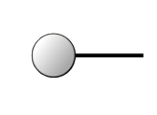

The ABC of Endpoints
Address
Host & Consume
Binding
A
Where to find the service
Example: http://localhost:8001/MathService
Service
Contract
How to communicate with the service
Example: BasicHttpBinding
B
What the service can do for you
Example: [OperationContract]
int Add(int num1, int num2);
C

Slide 66
Sending a WCF Message
Host & Consume
Once you got all of these information:
A configuration file is generated for the client
This configuration file is then used to create a proxy
Allows him to connect to the service
Depending on the binding, a specific channel is created
Messages are sent through this channel

Slide 67
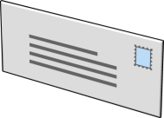

Sending a WCF Message
Host & Consume
Client
Proxy
1 – Proxy initiates connection:
http://localhost:8001/MathService
2 – Channel creation with binding:
BasicHttpBinding (Sent through HTTP protocol)
Channel
Channel
Channel
Binding
Encoding
Message
3 – Message sending:
Call Add(int num1, int num2)
Transport
channel

Slide 68
Receiving a WCF Message
Host & Consume
WCF Dispatcher
Service
6 – Service execution:
Call the method the client asked
5 – Dispatch request:
In function of service called by the client
Endpoints
Channel
Channel
Channel
Message
Encoding
4 – Message receiving
Transport
channel

Slide 69
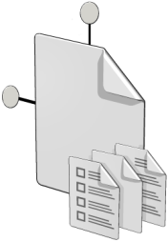
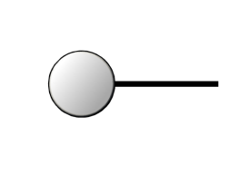
What’s inside a service ?
Host & Consume
Service
.NET Classes
and Interfaces
Service
Host
Endpoints
Notes:
Endpoints can also be used for Metadata Exchange

Slide 70
Life Cycle of a Self-Hosted WCF Service
Host & Consume
Using the namespace System.ServiceModel
1
Instantiate a Service Host object
System.ServiceModel.ServiceHost
2
Add a service Endpoint with :
Contract, Binding, Address
3
Open the ServiceHost to start listening

Slide 71
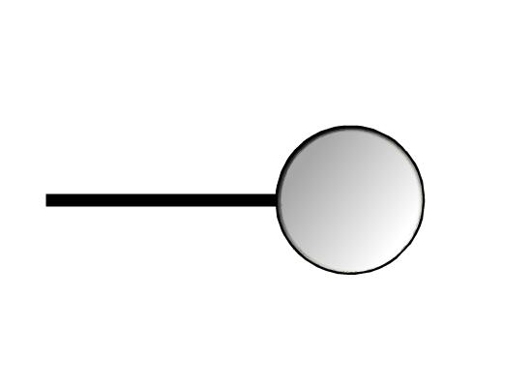

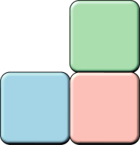
Life Cycle of a Self-Hosted WCF Service
Host & Consume
4
Prevent the ServiceHost from closing (i.e Console.ReadLine())
5
Close and dispose of the ServiceHost object
ServiceHost
Service type
Address

Slide 72
Hosting the Service (1/3)
Host & Consume
The service can be hosted in any type of application
In Console or Windows applications, add a WebHttpBinding endpoint with a WebHttpBehavior

Slide 73
Hosting the Service (2/3)
Host & Consume
var host = new ServiceHost(typeof(FlashCardservice),
new Uri(baseAddress));
var service =
host.AddServiceEndpoint(typeof(IFlashCardsService),
new WebHttpBinding(), "");
service.Behaviors.Add(new WebHttpBehavior());
host.Open();

Slide 74
Hosting the Service (3/3)
Host & Consume
The service can be hosted in any type of application
In web applications, add a WebServiceHostFactory to the .svc file
<%ServiceHost language=c# Service="FlashCardsService" Factory=System.ServiceModel.Activation.WebServiceHostFactory%>

Slide 75
Calling a WCF Service
Host & Consume
To call a WCF Service, the client needs the following :
A channel over which to pass messages
Transport channel at the bottom
The makeup of the channel derives from the binding
A client-side representation of the contract
Referencing the service contracts assembly
Generating artifacts from metadata

Slide 76
Calling a WCF Service
Host & Consume
To call a WCF Service, the client neads the following :
A way of creating WCF messages to pass across the channel and a way of retrieving message contents
An address for the WCF service

Slide 77



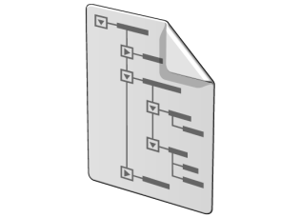
Sending a WCF Message
Host & Consume
Running
Service
Implements
Service Assembly
Service Class
Service
Metadata
Generate
Service Interface
Generate
Service
Proxy
Generate
ServiceModel Metadata Utility Tool (Svcutil.exe) generates metadata and artifacts
Implements
Proxy Artifacts

Slide 78
Consuming a service
Host & Consume
Using the ChannelFactory class
Reference the Service Contracts assembly
Instantiate a typed Channel Factory with the binding and the address of the service
System.ServiceModel.ChannelFactory<T>
T represents the type of the contract
Call the CreateChannel() method to contact the service and create a proxy
Start calling the methods…

Slide 79


File-based configuration
Host & Consume
File-based configuration
app.config, web.config, and machine.config files
Change WCF configuration without recompiling
Also usable: programmatic configuration
Provides greater control of your WCF configuration
Takes precedence over file-based configuration
Much less used

Slide 80
Identifying WCF Entries in Config Files
Host & Consume
Host configuration file
<system.serviceModel>
<services>
<service name="ServiceImplementation.HelloService">
<endpoint
address="http://localhost:1664/HelloService"
binding="basicHttpBinding"
contract="ServiceContract.IService"/>
</service>
</services>
</system.serviceModel>

Slide 81
Identifying WCF Entries in Config Files
Host & Consume
Client configuration file
<system.serviceModel>
<client>
<endpoint name="tcpEndpoint"
address="http://localhost:1664/HelloService"
binding="basicHttpBinding"
contract="ServiceContract.IService"/>
</client>
</system.serviceModel>

Slide 82
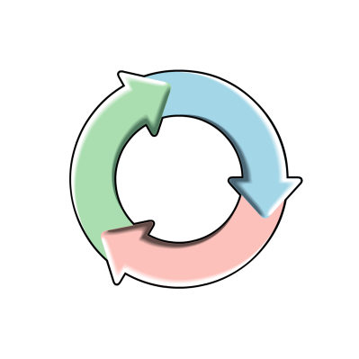





Obtaining Service Information
Host & Consume
Obtain information from Service metadata and generate artifacts
WCF Service
WCF types
MEX endpoint
Artifacts

Slide 83
Consuming a service
Host & Consume
Using generated artifacts – Mex (Metadata Exchange)
Add a reference to the service (“Add Service Reference”)
The tool Svcutil.exe generates code from the metadata of the service:
Proxy classes and interface
Instantiate a proxy service class object
Start calling the methods…

Slide 84
Calling the Service From a Client
Host & Consume
The client can be any type of application
The server is called with its URI
In Windows application, can use the WebClient class and its OpenRead method
var client = new WebClient();
var stream = client.OpenRead("http://localhost:8000/Teachers");

Slide 85
Calling the Service From a Client
Host & Consume
Returned JSON data can be de-serialized with the DataContractJsonSerializer class
In the System.Runtime.Serialization.Json namespace
var ser = new DataContractJsonSerializer(typeof(List<Teacher>));
var teachers = ser.ReadObject(stream) as List<Teacher>;

Slide 86
Questions?

Slide 87
Quiz
Name some WCF frameworks:
_________________________________________________________
On what standards are the WCF Data Services based?
_________________________________________________________
Which client applications can use WCF?
___________________________________________________
Notes:
Answers:
1) WCF - WCF Data Services - WCF RIA Services
2) RESTFUL
3) Every application

Slide 88
Exercise
Service Oriented Architecture
Create a simple application that will consume your previously created service
Change binding from HTTP to TCP and make it work

Slide 89

The End
WCF and Web Services
That’s all folks!

